Slide 1
Linux Foundation – Introduction to Kubernetes

Slide 2
From Monolith to Microservices
Legacy Monolith
Modern Microservices
A monolith application is tightly coupled and almost possible to separate and a nightmare ot manager and deployed on super expensive hardware
Legacy Monolith
  Problem : New features and improvements added to code complex ( loading, compiling, building times increase with every new update )
  Problem : Rather expensive hardware
  Problem : The monolith runs as a single process, the scaling of individual features of the monolith is almost impossible
    Scaling can be achieved by manually deploying a new instance of the monolith on another server or load balancing ( pricy solution )
  Patches and Migrations cause down time and disruptions in service
    touch to keep all systems at the same patch level and introduce new possible licensing costs
Modern Microservice
  Deployed individually on separate servers provisioned with few resources ( only what is required by each service and the host system itself )
  Aligned with SOA and Event Driven Architecture where applications are composed of small independent processes which communicate with each other through APIs over a network.
  Distributed system are complex, but good for stability. Each microservice can be scaled individually
  Very little downtime since upgrade are rolled out seamlessly one service at a time which make it a lot faster and more agile
    Separate teams focus on separate features thus being more productive and cost effective

Slide 3
Refactoring
Two Types
  Big Bang Approach
    Focus all efforts with the refactoring of the monolith
    Postponing the development and implementation of any new features
  Incremental Refactoring
    New features are developed and implemented as modern microservices which communicate through APIs without appending to the monoliths code
    Features are refactored out of the monlith which slowly fades away
  Other considerations
    Which components to separete from the monolith and in what order
    how to decouple the database to separate data complexity form application logic
    test microservices and their dependencies

Slide 4
Challenges
If dealing with Cobol or assembler it may be more economical to rebuild.
A poorly designed legacy application should be re-designed and re-built from scratch
Problem : Deploying many modules on a single physical or virtual server, chances are different libraries and runtime environment may conflict
  Use Containers
    consistent software environments for developers, tests and production
    ensure application portability from physical bare-metal machines to Virtual Machines
    each container has its own execution environment thus avoiding conflicts
    Higher Server Utilization
    Individual Module Scalability

Slide 5
Container Orchestration
Container Orchestration
  We would like to have a fault tolerant and scalable solution which can be achieved by creating a single controller/management unit after connection multiple nodes together
Reason for Orchestration
  Fault-tolerance
  On-demand scalability
  Optimal resource usage
  Auto discovery to automatically discover and communicate with each other
  Accessibility from the outside world
  Seamless updates/rollback without any downtime
Container Orchestrators are tools which group systems together to form cluster which containers deployment and management is automated at scale while meeting the requirements mentioned abov
Examples : Amazon Elastic Container Server, Kubernets, Marathon, Nomad, Docker Swarm

Slide 6
Container Orchestrators
Why Use Container Orchestrators
  Group Host together while creating a cluster
  Schedule containers to run on hosts in the cluster based on resource availability
  Bind containers and storage resources
  Group sets of similar containers and bind them load balancing constructs to simplify access to containerized applications by crate a level of abstraction between the containers and the user
  Manage and optimize resource usage
  Allow for implementation of policies to secure access to applications running inside containers
Where to Deploy Container Orchestrators

Slide 7
What is Kubernetes
From Borg to Kubernetes
Kubernetes is an open-source system for automating deployment, scaling, and management of containerized applications."
  Think of Kubernetes as the pilot of a ship of containers
  Also called k8s which is pronounced Kate
Release Cycle is every three months
From Borg ( a container and workload orchestrator for its global operations for more than a decade ) to Kubernetes
  Some of the features can be traced back to Borg or lessons learned from it are:
    API Servers
    Pods
    IP-per-Pod
    Services
    Labels

Slide 8
Kubernetes Features
Automatic bin packing
  Kubernetes automatically schedules containers based on resource needs and constraints, to maximize utilization without sacrificing availability.
Self-healing
  Kubernetes automatically replaces and reschedules containers from failed nodes. It kills and restarts containers unresponsive to health checks, based on existing rules/policy. It also prevents traffic from being routed to unresponsive containers.
Horizontal scaling
  With Kubernetes applications are scaled manually or automatically based on CPU or custom metrics utilization.
Service discovery and Load balancing
  Containers receive their own IP addresses from Kubernetes, while it assigns a single Domain Name System (DNS) name to a set of containers to aid in load-balancing requests across the containers of the set.
Automated rollouts and rollbacks
  Kubernetes seamlessly rolls out and rolls back application updates and configuration changes, constantly monitoring the application's health to prevent any downtime.
Secret and configuration management
  Kubernetes manages sensitive data and configuration details for an application separately from the container image, in order to avoid a re-build of the respective image. Secrets consist of sensitive/confidential information passed to the application without revealing the sensitive content to the stack configuration, like on GitHub.
Storage orchestration
  Kubernetes automatically mounts software-defined storage (SDS) solutions to containers from local storage, external cloud providers, distributed storage, or network storage systems.
Batch execution
  Kubernetes supports batch execution, long-running jobs, and replaces failed containers.

Slide 9
Why Use Kubernetes
Portable and Extensible
  can be deployed in many environments such as local or remote vritual machines, bare metal, public/hybrid/multi-cloud sets
  Supports many 3rd party open source tools
Modular and Pluggable
  orchestrates modular, decoupled microservices type applications
  its architecture follows decoupled microservices patterns.
functionality can be extended by writing:
  custom resources,
  operators,
  custom APIs,
  scheduling
  rules
  plugins.

Slide 10
Kubernetes Architecture Introduction
Kubernetes Architecture
  Components
    Control Plane
    Master and Worker Nodes
    cluster State Management with etcd
    Network Setup Requirements
  Container Network Interface (CNI) as Kubernetes network specification
  At a very high level
    One or more Master Node which are part of the control plane
    One or more worker nodes

Slide 11
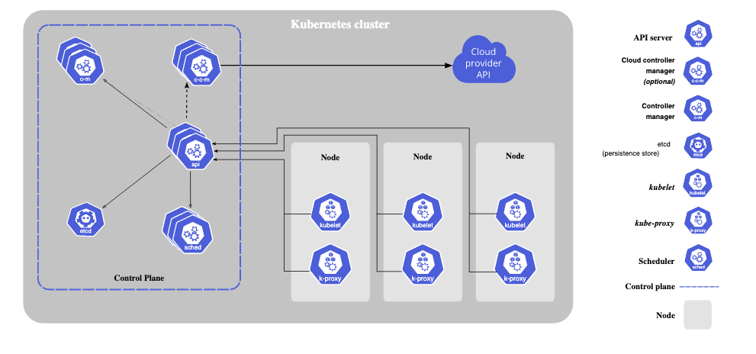
High Level Overview

Slide 12
Master Node Overview
Provides a running environment for the control plane.
  The control plane is responsible for managing the state of a Kubernetes cluster
    Control Plane contains agents with very distinct roles in the cluster’s management
    User sends request to the control plane either through the CLI, Web Interface or API
      To ensure fault tolerance, master node replicas can be added to the cluster, configured in High-Availability mode
        One of the master node is dedicated to actively managing the cluster the control plane components stay in sync across master node replicas
    etcd
      A distributed key-value store which only holds cluster state related data
        May be configured on a Master node ( stacked topology )
          Hight Availability node replicas ensure the the data store resiliency as well
        May be configured on a dedicated host ( external topology ) to help reduce the chances of data store loss by decoupling it from the other control plane agents
          The etcd hosts have to be separately replicated for HA

Slide 13
Master Node Components
A master node runs the following control plane components
  API Server
  Scheduler
  Controller Managers
  Data Store
In addtion the master node runs
  Container Runtime
  Node Agent
  Proxy

Slide 14
Master Node Components : API Server
All the administrative tasks are coordinated by the kube-apiserver
A Central Control plane component running on the master node.
Intercepts RESTFull calls from the users, operators and external agents then validate and process them
  During processing the API Server read the Kubernetes cluster’s current state from the etcd and after a call’s execution the resulting state of the Kubernetes cluster is saved in the distributed key-value data store persistence
  The API Server is the only master plane component to talk to the etcd data store
    Both to read from and to save kubernetes cluster state information acting asa a middle interface for any other control plane agent inquiring about the cluster’s state
Highly configurable and customizable
  scale horizontally
  supports the addition of custom secondary API Servers
    A configuration that transforms the primary API server into a proxy to all secondary custom API and routes all incoming RESTful calls to them based on custom define rules

Slide 15
Master Node Components : Scheduler
Assign new workload objects such as pods to nodes
  Based on Kubernetes cluster state and new object’s requirements
Obtains from the etcd data store, via API Server, resource usage dat for each worker node in the cluster and also form the API Server the new object’s requirements which are part of the configuration data
  may include constraints such as scheduling work on a node labeled with disk==ssd key/var pair
  Also takes into account Quality of Service requirements, data locality, affinity, anti-affinity, taints, toleration, cluster topology
When all the data is available the possible node candidate are scored with priorities and the result is communicated back to the API Server which then delegates the workload deployment with other control plane agents
Configurable through policies, plugins and profiles, custom schedulers
More important and complex in a multi-node Kubernetes cluster

Slide 16
Master Node Components : Controller Managers
Control Plan components on the mater node running controllers to regulate the state of the Kubernetes cluster
Watch Loops for continuously running and comparing the cluster’s state ( provided by the objects’ configuration data ) with its current state ( obtained from etcd data store via the API Server)
In case of a mismatch corrective action is taken in the cluster until its current state matches the desired state
Kube Controller Manger
  Have controllers responsible to act when nodes become unavailable to ensure pod counts aare as expected, to create endpionts, service account and API Access Tokens
Cloud Controller Manager runs the controllers responsible to interact with the underlying infrastructure of a cloud provider when the nodes become unavailable to manage storage volumes when provided by a cloud service and to manage load balancing and routing

Slide 17
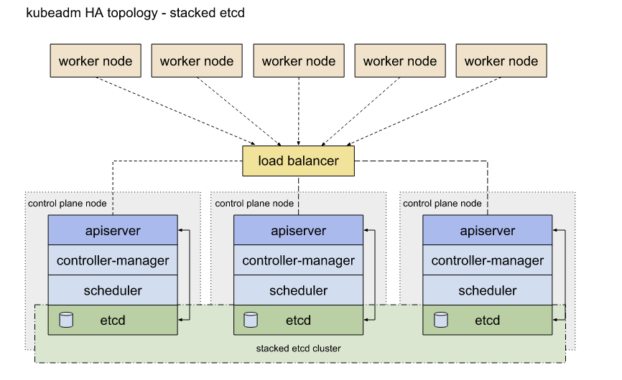
Master Node Components : Data Store
etcd is use to persist Kubernetes cluster’s state
  New data is written only by appending it and data is never replaces in the data store
  Obsolete data is compacted periodically to minimize the size of the data store
Only the API Server is able to communicate with the etcd data store
etcdctl is the etcd cli management tools which provides backup, snapshot and restore capabilities and replication
kubeadm by default provision stacked etcd master nodes were the data store runs alongside and shares resource with other control plan compnents on the same master node.

Slide 18
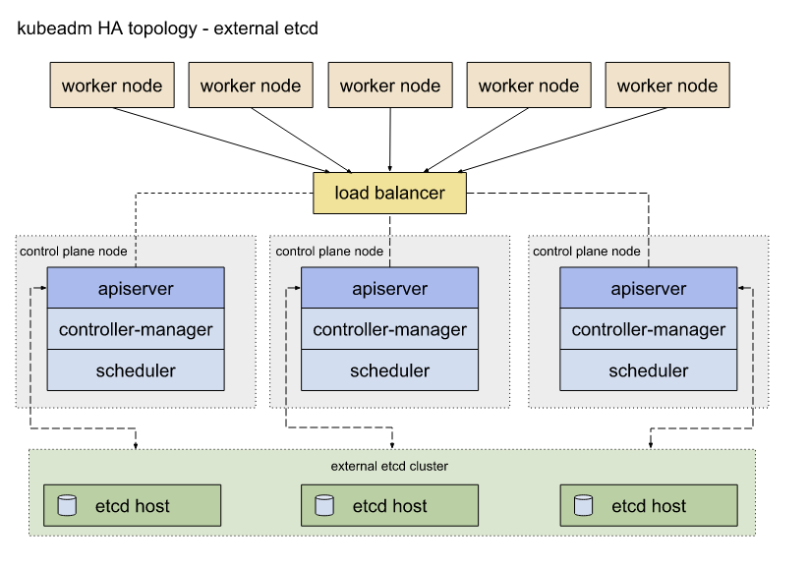
Master Node Components : Data Store
For data store isolation, etcd can be configured externally where the data is separated on a separate host thus reducing etcd failure

Slide 19
Master Node Components : Data Store
Raft Consensus Algorithm allows a collection of machines to work as a coherent group that can survive the failures some of its members
  At any given time one of the nodes in the group will be the master
  etcd handles master elections and can tolerate node failure, includes master node failures. Any node can be treated as a master
ETCD is also used to store configuration details such as subnets, ConfigMaps, Secrets

Slide 20
Worker Node Overview
Worker Node Components
Worker Node Components : Container Runtime
A worker node provides a running environment for client applications
Through containerized microservices these applications are encapsulated in Pods, controlled by the cluster controlled by cluster control plane agents running on the master node.
Pods are scheduled on worker nodes where they find the required compute, memory and storage resource to run and network resources to communicate with the world
  Pod – Smallest scheduling unit in Kubernetes
    logical collection of one or more containers scheduled together
    can be started, stopped or rescheduled as a single unit of work
  In a multi worker Kubernetes cluster the network traffic between client users and the containerized applications deployed in Pods is handled directly by the worker nodes and it not through the master nodes
Worker Node Components
  container Runtime
  Node Agent – kubelet
  Proxy – kube-proxy
  Addons for DNS, Dashboard user interface, cluster-level monitoring and logging
Worker Node Components
  Kubernetes does not directly handle containers and must have a container runtime on the node where a Pod and it containers are to be scheduled ( ex. Docker)
  Other Containers
    CRI-O lightweight container for runtime for Kubernetes which supports Docker Image registries
    co0ntainerd A simple and portable container runtime providing robustness
    frakti A hypervisor based container runtime for Kubernetes

Slide 21
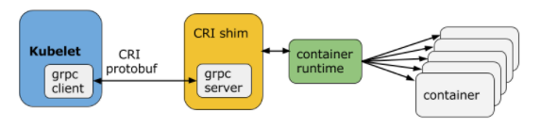
Worker Node Componets: Node-Agent – Kublet
An agent running on each node and communicates with the control plane components from the master node
Receives pod definitions, primarily from API Sever, and interacts with the container runtime on the node to run containers associated with the Pod
Monitors the health and resources of Pods running the containers
Connects to container runtimes through a plugin interface – The (C)ontainer (R)untime (I)nterface
  consist of protocol buffers, gRPC API, libraries and additional specifications and tools that are currently under development
  Kubelet uses a shim applications which provides a clear abstraction layer between kubelet and the container run time
  The CRI implements two services
    Image Service Responsible for all the image-related operations
    Runtime Service Responsible for all the Pod and Container related operations
  Advantage of the CRI : Allows the user of different container runtimes without the need to recompile
    The container runtime must implement the CRI

Slide 22
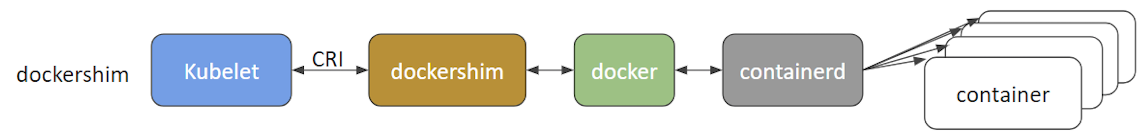
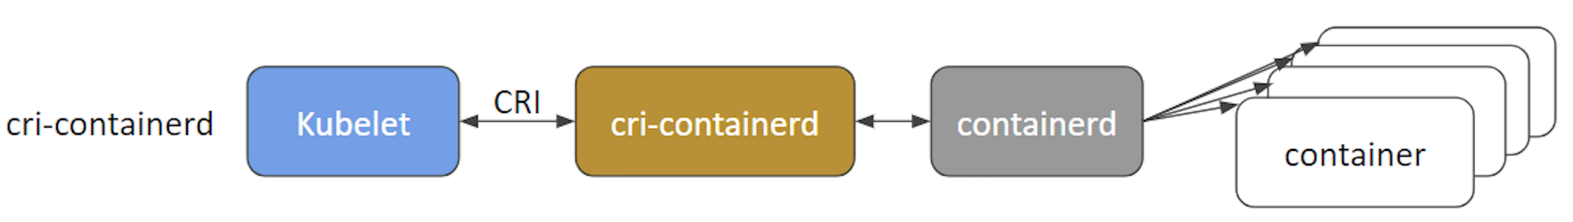
Worker Node Components: kubelet - CRI shims
docker shim – Containers are created using Docker installed on works nodes
cri-containerd – directly use containerd to create and manage containers
CRI-O – In principle any OCI-compliant runtime can be plugged in ( see http://cri-o.io/ )
Frajtu
  enables CRI through hardware virtualization
  achieve a higher level of security and isolation than the traditional linux os containers
  Based on cgroups and name spaces
  aimed at enabling kubelet to interact with Kata Containers

Slide 23
Worker Node Components – Kube proxy,
Addons
Networking Challenges
Network agent which runs on each node responsible for dynamic updates and maintenance of all networking rules on the node.
abstracts the details of Pods networking and forwards connectin request to pods
Responsible for TCP, UDP, SCTP stream forwarding of round-robin forwarding across a set of Pod backends
implements forwarding rules defined by users through Server API Objects
Add Ons
  DNS – Cluster DNS is a DNS server required to assign DNS records to Kubernetes objects and resources
  Dashboard – A general purpoose web-base user interface for cluster management
  Monitoring – collects cluster level container metrics and save them to a central data store
  Logging – collect cluster level container logs and save them to a central log store for analysis
Networking Challenges
  Decoupled microservices based applications rely heavily on netowkring in order to mimic the tight coupling once available in the monlithic era
  Challenges – All these networking challenges must be address before deploying a Kuernetes cluster
    Container to container communication inside Pods
    Pod to Pod communication on the same node and across cluster nodes
    Pod to Service communication with the same namespace and across cluster namespaces
    External to Service communication for clients to access applications in a cluster

Slide 24
Container to Container Comunication inside ports
Making use of the underlying host OS kernel virtualization features a container runtime creates an isolated network space for each container it starts
On linux the isolated network space is referred to as a network name space
  Can be shared across containers with the host OS
When a pod is started, a special Pause container is initialized by the Container Runtime for the sole purpose to create a network namespace for the pod.
  All additional containers created through user request running inside the Pod will share the Pause container’s network name so they can to eachother via localhost

Slide 25
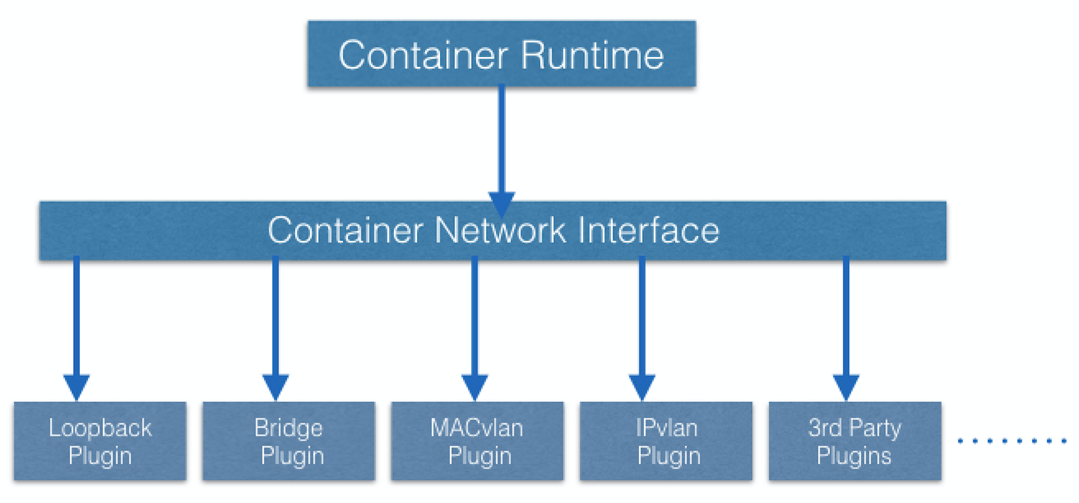
Pod to Pod Communication Across Nodes
Pods are expected to communicate with all other pods in the cluster, without the implementation of Network Address Translation
Treats pods as virtual machines on a network
  model is call IP-per-Pod and ensures Pod-to-Pod communication
Containers
  Share the pod’s network namespace and must coordinate ports assignment inside the Pod just as applications would on a VM all the while being able to communicate with each other on localhost ( inside a pod)
    Problem : Containers are integrated with the overall Kubernetes networking model through the user of the Container Network Interface (CNI) supported by CNI plugins.
The container runtime offloads the IP Assignment ot CNI which connects the underlying configured plugin such as Bridge or MACvlan to get the IP Address
  Once the IP Address is given by the respective plugin, CNI forwards it back to the requested runtime

Slide 26
Pod to External World Communication
A Pod may require accessibility from the outside world
Kubernetes enables external accessibility through services
  complex encapsulations fo network routing rule definitions store in iptables on cluster nodes and implemented by kube-proxy
By exposing services to the external world with the aid of kube-proxy applications become accessible from the outside the cluster over a virtual ip address

Slide 27
Installing Kubernetes – Kubernetes Configuration
can be installed using different cluster configurations
  All in One Single Node Installation
    Master and Worker Components are installed and running on a signle node
    Good for learning, development and testing, but not production
    Minikube – Installation tools aimed at single node cluster installations
  Single Master and Multi Worker Installation
    A single Master node running a stacked etcd instance
    Multiple worker nodes can be managed by the master node
  Single Master with Single Node etcd and Multi Worker Installation
    A single master node with an external etcd instance
    Multiple worker nodes can be managed by the master node
  Multi Master and Multi Worker Installation
    Multiple Master nodes configure for High Availability with each Master node running a stacked etcd instance.
    The etcd instances rae also configured in an HA etcd cluster and multiple worker node can be managed by the HA masters
  Mutli Master with Mutli Node etcd and Multi Worker Installation
    In this setup, we have multiple master nodes configured in HA mode, with each master node paired with an external etcd instance
    The external etcd instances are also configured in an HA etcd cluster, and multiple worker nodes can be managed by the HA masters
    Most advanced cluster configuration recommended for production environment
  For production Multi host envorinments that support high availability control plane setups and multiple works node for client workload

Slide 28
Installing Kubernetes – Infrastructure for Kubernetes Installation
Localhost Installation
On Premise Bare Metal
First decide on the installation type and then decide on the infrastructure which is determined if the environment type is Production or Development
Considerations
  Should we set up Kubernetes on bare metal, public or private or hybrid cloud
  Which OS should we we
  Which networking solution should we use
LocalHost Installation
  Tools
    Minikube – single-node local Kubernetes cluster, recommended for a learning environment deployed on a single host.
      Easiers and most preferred method to create an all in one Kubernetes setup locally
    Kind – multi-node Kubernetes cluster deployed in Docker containers acting as Kubernetes nodes, recommended for a learning environment.
    Docker Desktop – including a local Kubernetes cluster for Docker users.
    MicroK8s – local and cloud Kubernetes cluster, from Canonical.
    K3S – lightweight Kubernetes cluster for local, cloud, edge, IoT deployments, from Rancher.
On Premise Bare Metal
  On Premise Virtual Machines – can be installed on VMs created with Vagrant, VMware, KVM or another Configuration Management Tool in conjunction with a hypervisor software
    Tools to automate the installation – Ansible or kubeadm
  On Premise Bare Metal – Most tools used to install kubernets on VMS can be used to install with bare metal installation as well

Slide 29
Kubernetes Installation Tools/Resources
kubeadm
  secure and recommended method to bootstrap a multi-node production ready Highly Available Kubernetes cluster, on-prem or in the cloud.
  can also bootstrap a single-node cluster for learning
  has a set of building blocks to setup the cluster, but it is easily extendable to add more features.
    does not support the provisioning of hosts.
kubespray
  install Highly Available production ready Kubernetes clusters on AWS, GCE, Azure, OpenStack, vSphere, or bare meta
  Based on Ansible
kops
  we can create, upgrade, and maintain production-grade, Highly Available Kubernetes clusters from the command line
  can provision the machines as well.
kube-aws
  we can create, upgrade and destroy Kubernetes clusters on AWS from the command line
  he project aims to teach all the detailed steps involved in the bootstrapping of a Kubernetes cluster.

Slide 30
A Local Kubernetes Cluster – Introduction
Minikube is the easiest and most popular method to run an all-in-one Kubernetes cluster in a virtual machine (VM) locally on our workstations
responsible for
  installation of Kubernetes components
  cluster bootstrapping,
  cluster tear-down when no longer needed.
few additional tools aimed to ease the user interaction with the Kubernetes cluster
  Minikube release also supports multi-node Kubernetes clusters, this feature is still experimental.

Slide 31
Requirements for Running Minikube
Type 2 Hypervisor is need ( interacts directly with the hardware) or a Container Runtime should be installed on the local workstation to run in conjunction with MiniKube
libmachine ( https://github.com/docker/machine/tree/master/libmachine ) which invokes the Hypervisor that provisions the VM which hosts a single-node Kubernetes cluster or the Container Runtime to run the Container that host the cluster
Used kubeadm to provision the Kubernetes cluster
Although virtual box is is Minikube’s original hypervisor driver several other drivers are supported by Minikube when provisioning the environment in which the Kuernetes cluster is to be bootstrapped
Requirements to run
  VT-x/AMD-v virtualization must be enabled on the local workstation in BIOS, and/or verify if virtualization is supported by your workstation's OS.
  kubectl ( https://kubernetes.io/docs/tasks/tools/install-kubectl/ )
  Type-2 Hypervisor or Container Runtime
    On Linux VirtualBox, KVM2 or Docker and Podman runtimes
    On macOS VirtualBox, HyperKit, VMware Fusion, Parallels or Docker runtime
    On Windows VirtualBox, Hyper-V, or Docker runtime.
Minikube supports a
  --driver=none on linux that run the Kubernetes components directly on the host os
  --driver=docker for linux, macOS and Windows
  --driver=podman on linux

Slide 32
Installing Minikube on Linux
Verify virtualization support – grep -E --color 'vmx|svm' /proc/cpuinfo
Install Virtual Box
Install Minikube
  curl -Lo minikube https://storage.googleapis.com/minikube/releases/latest/minikube-linux-amd64 && chmod +x minikube && sudo mv minikube /usr/local/bin/
    /latest/ with a particular version, such as /v1.13.0/ will download that specified version.
Start Minikube
  minikbue start command bootstrap a single-node cluster with the latest stable Kubernetes version release
  For a specific version the --kubernetes-version option can be used
minikube status provides informaiton
minikube stop

Slide 33
Intalling Linux : Minikube CRI-O
CRI-O – an implementation of the Kubernetes CRI (Container Runtime Interface) to enable using OCI (Open Container Initiative) compatible runtimes."
minikube start --container-runtime cri-o ( --container-runtime can also be cri-o or containerd )
  By describing a running Kubernetes pod, we can extract the Container ID field of the pod that includes the name of the runtime:
  $ kubectl -n kube-system describe pod kube-scheduler-minikube | grep "Container ID"
  Container ID: cri-o://1090869caeea44cb179d31b70ba5b6de…
login via ssh into the Minikube's VM: – minikube ssh

Slide 34
Accessing Minikube
Accessing through CLI
Accessing Through the Web
Any Healthy running Kubernetes cluster can be access by
  Command Line Interface (ex. curl )
  Web-based User Interface from a web browser
  API from CLI or programmatically
Accessing through CLI
  lubetcl – Kubernetes Command Line Interface (CLI) client to manage cluster resources and applications
  Can be used standalone or part of scripts
  Once all required credentials and cluster access points have been configured for kubectl it can be used remotely from anywhere to access a cluster
Accessing through the Web
  Kubernetes Dashboard provides a Web Base User Interface to interact with a Kubernetes cluster to manage resources and containerized applications
Accessing Minikube: API(s)
  Main Component of the Kubernetes is the API Server responsible for exposing the API(s) – which allow operators and users to directly interact with the cluster using both CLI Tools and Dashobard

Slide 35
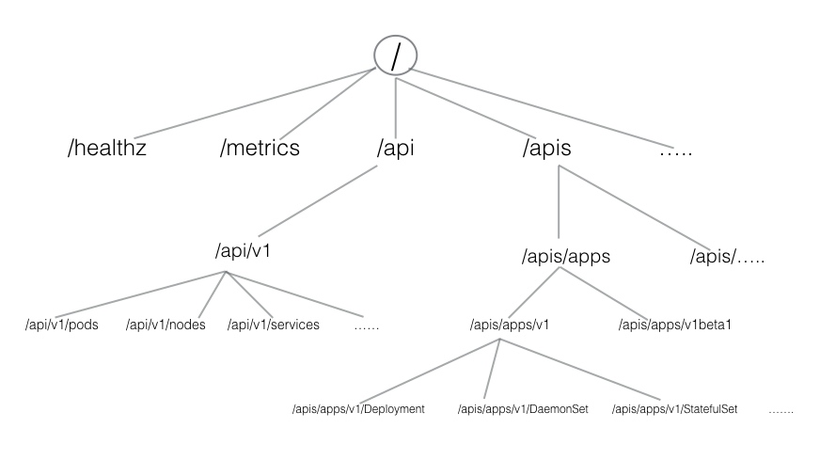
Accessing Through the Web
Main Component of the Kubernetes is the API Server responsible for exposing the API(s) – which allow operators and users to directly interact with the cluster using both CLI Tools and Dashboard
HTTP API Directory can be divided into three groups
  Core Group ( /api/v1 ) – Pods, Services, Nodes, Namespaces, Config Maps and Secrets
  Named group includes objects in /apis/$NAME/$VERSION – imply different levels of of stability and support
      Alpha – May be dropped at any point in time
      Beta – Tested, but the semantics of objects may change in incompatible ways in different release
      Stable Level appears in release software for many subsequent versions
  System Wide – consist of API Endpoints like /healthz, /logs /metrics /ui

Slide 36
Installing Kubectl on Linux
Download the latest table binary
  curl -LO "https://storage.googleapis.com/kubernetes-release/release/$(curl -s https://storage.googleapis.com/kubernetes-release/release/stable.txt)/bin/linux/amd64/kubectl" && chmod +x kubectl && sudo mv kubectl /usr/local/bin/
There is specific bash completion for k8s
For the macintosh you can use brew install ( kubernetes or kubernetes-cli )
  https://kubernetes.io/docs/tasks/tools/

Slide 37
Kubernetes Configuration File
To access the Kubernetes cluster, kubectl client needs:
  The master node endpoint
  appropriate credentials to be able to securely interact with the API Server running on the master node
When starting Minikube the startu process creates by default a configuration file config inside the .kube directory
  The configuration file has all the details required by kubectl
  kubectl parse this file to find the master node’s connection endpoint along with the credentials
Multiple kubeconfig can be configured with a single kubectl client
Minikube create the configuration file whereas other tools may not

Slide 38
K8s Configuration File
$ kubectl config view
apiVersion: v1
clusters:
- cluster:
certificate-authority: /home/student/.minikube/ca.crt
server: https://192.168.99.100:8443 // The endpoint of the server
name: minikube
contexts:
- context:
cluster: minikube
user: minikube
name: minikube
current-context: minikube
kind: Config
preferences: {}
users:
- name: minikube
user:
client-certificate: /home/student/.minikube/profiles/minikube/client.crt
client-key: /home/student/.minikube/profiles/minikube/client.key
kubectl cluster-inf display information about the cluster

Slide 39
Kubernetes Dashboard
Kubernetes Dashboard with kubectl proxy
Demo
APIs with 'kubectl proxy'
https://kubernetes.io/docs/tasks/access-application-cluster/web-ui-dashboard/
A web based user interface
To access the dashboard : minikube dashboard
Kubernetes Dashboard with kubectl proxy
  kubectl proxy → authenticates with the API server oon the master node and make the dashboard available on a slightly different URL through port 8001
Demo
  minikube addons list
  minikube addson enable metric-server
  minikube dashboard
APIs with kubeclt proxy
  When kubectl proxy is running can send request to the API over local on the default proxy port (8001)
  ex curl http://localhost:80001 → Requested all the API endpoints from the API server

Slide 40
APIs with Authentication
When not using kubectl proxy, we need to authenticate to the API Server when sending API Requests
Authenticate by providing a Bearer Token when issuing a curl or by proving a set of keys and certificates
  Bearer Token – An Access token which is generated by the authentication server ( API Server on the Master Node ) and given back to the client
    Algorithm
      Get the Token
        TOKEN=$(kubectl describe secret -n kube-system $(kubectl get secrets -n kube-system | grep default | cut -f1 -d ' ') | grep -E '^token' | cut -f2 -d':' | tr -d '\t' | tr -d " ")
      Get the server endpoint
        APISERVER=$(kubectl config view | grep https | cut -f 2- -d ":" | tr -d " ")
      Confirm the APIServer stored in the samp IP as the Kubernetes mater IP
        $ echo $APISERVER
          https://192.168.99.100:8443
        $ kubectl cluster-info
          Kubernetes master is running at https://192.168.99.100:8443 …
      Access the server
        curl $APISERVER --header "Authorization: Bearer $TOKEN" --insecure
  Client Certificate
    Extract the Client Certificate and Client Key and Certificate Authority from the .kube/config
    Once extract they can be encode and passwed with a curl command
    curl $APISERVER --cert encoded-cert --key encoded-key --cacert encoded-ca
Demo

Slide 41
Kubernetes Object Model
Represent different persistence entities in Kubernets
  what containerized applications we are running
  The nodes where the containered applications are deployed
  Application resource consumption
  Policies attached to applications like restart/upgrade policies, fault tolerance etc.
With each boject, we declare our intent or the desired start in the object, in the spec section
Kubernetes system manages the status section for the boejcts where it records the actual state of the object
  At any given point in time the kubernetes control plane tries to match the object’s desired state
Example kubernetes Objects are
  Pods, ReplicaSets, Deployments, Namespaces
When creating an object, the object's configuration data section from below the spec field has to be submitted to the Kubernetes API server
  The spec section describes the desired state, along with some basic information, such as the object's name.
  API request to create an object must have the spec section as well as other details
Fields
  apiVersion is requried and specifies the API Endpoint
  kind – Specifies the endpoint ( can be Deployment, Pod, Relicaset, Namespace, Service
  metaData – Holds the object’s basic information such as name,labels, namespace

Slide 42
Kubernetes Object Model
  spec – A block that defines of the block defining the state of the Deployment object
  Once the deployment object is crated the kubernetes system attaches the status field to the object and populates it with all the necessary status fields.
Example of a Deployment Object’s Configuration
  apiVersion: apps/v1
  kind: Deployment
  metadata:
  name: nginx-deployment
  labels:
  app: nginx
  spec:
  replicas: 3
  selector:
  matchLabels:
  app: nginx
  template:
  metadata:
  labels:
  app: nginx
  spec:
  containers:
  - name: nginx
  image: nginx:1.15.11
  ports:
  - containerPort: 80

Slide 43
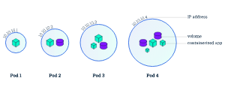
Pods
Simplest Kubernetes Object. – Logical collection of one or more containers which
  represents a single instance of the application
  shared the same network namespace ( share the same IP Address originally assigned to the Pod )
  Have access to mount the same external storage volumes
  Do not have the ability to self heal themsleves
    Have controllers which handle replication, fault tolerance and self-healing
  Single and Mutli Container Pods

Slide 44
Label Selectors
Replication Controllers
Select a subset of objects
Types
  Equality Based Selectors
    filtering of objects based on Label keys and values
    Matching is achieved using the =,==,!=
    Example : env==dev, env=dev
      Selecting objects where env Label is set to value dev
  Set Based Selectors
    filtering of objects based on a set of values
    use in,notin operators for label values and exist/does not exist operators for Label Keys
      Example env in (dev,qa) –> Selecting objects where the env label is set4 to either dev or qa
      !app – select objects with no label key app
Replication Controllers
  No longer recommended
  Ensure a specified number of repicase of a pd is running at any give time ( compares actual to desired state )
  Problem: We do not deply a Pod independently as it would not be able to restart since a Pod misses the much desired self healing feature
  Recommendation use Deployment Control which configures Repli9caSet

Slide 45
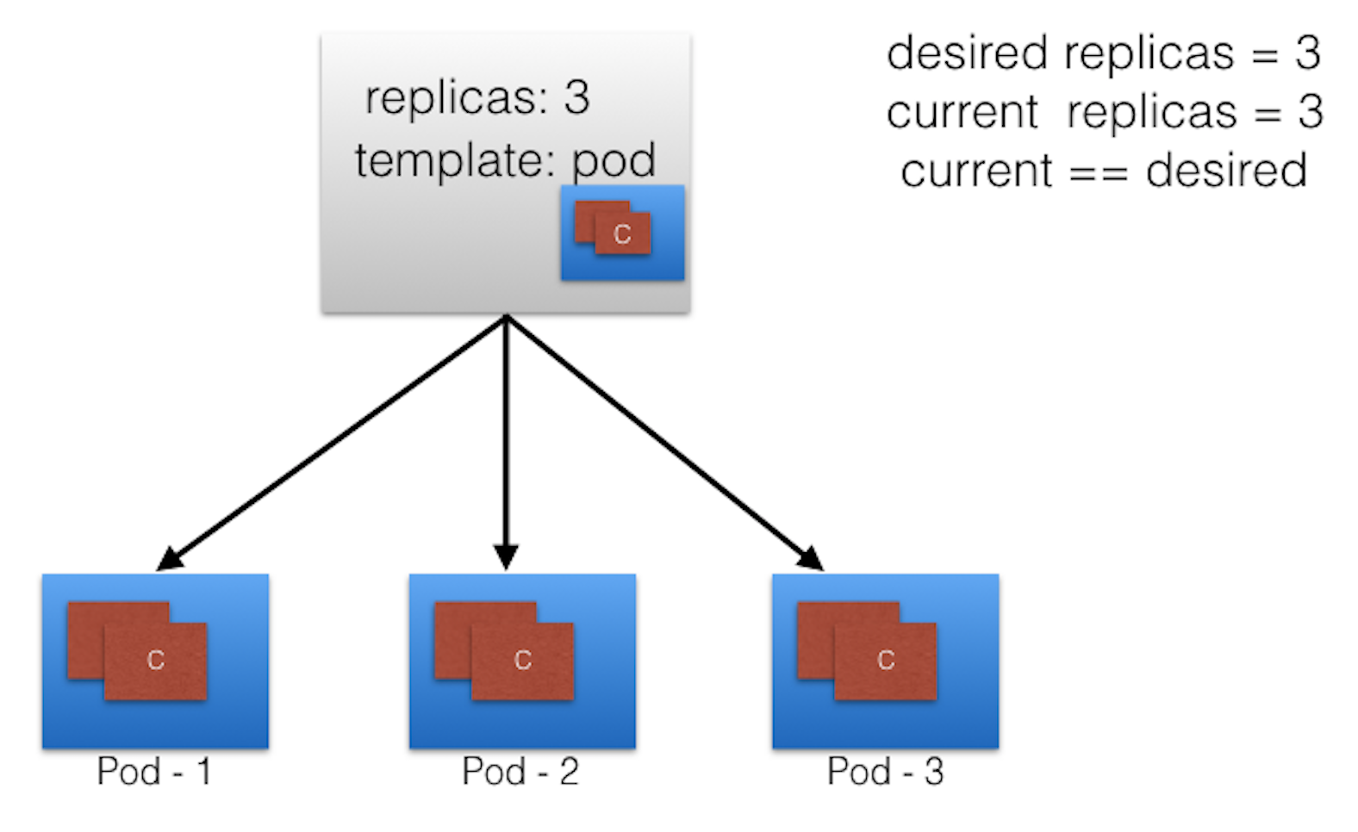
ReplicaSet I, III
Next generation replication controller
  implements replication and self healing aspects
  support equality and set based selectors
  Scaling can be accomplished manually or through the use of an autoscaler
When the replicate set is not longer matching the desired state and triggers a rquest for an additional pod to be created
Replica Set can be used independently as Pod controllers , but have a limited set of features
  Deployments create replica set which creates a pod.

